Slide 1
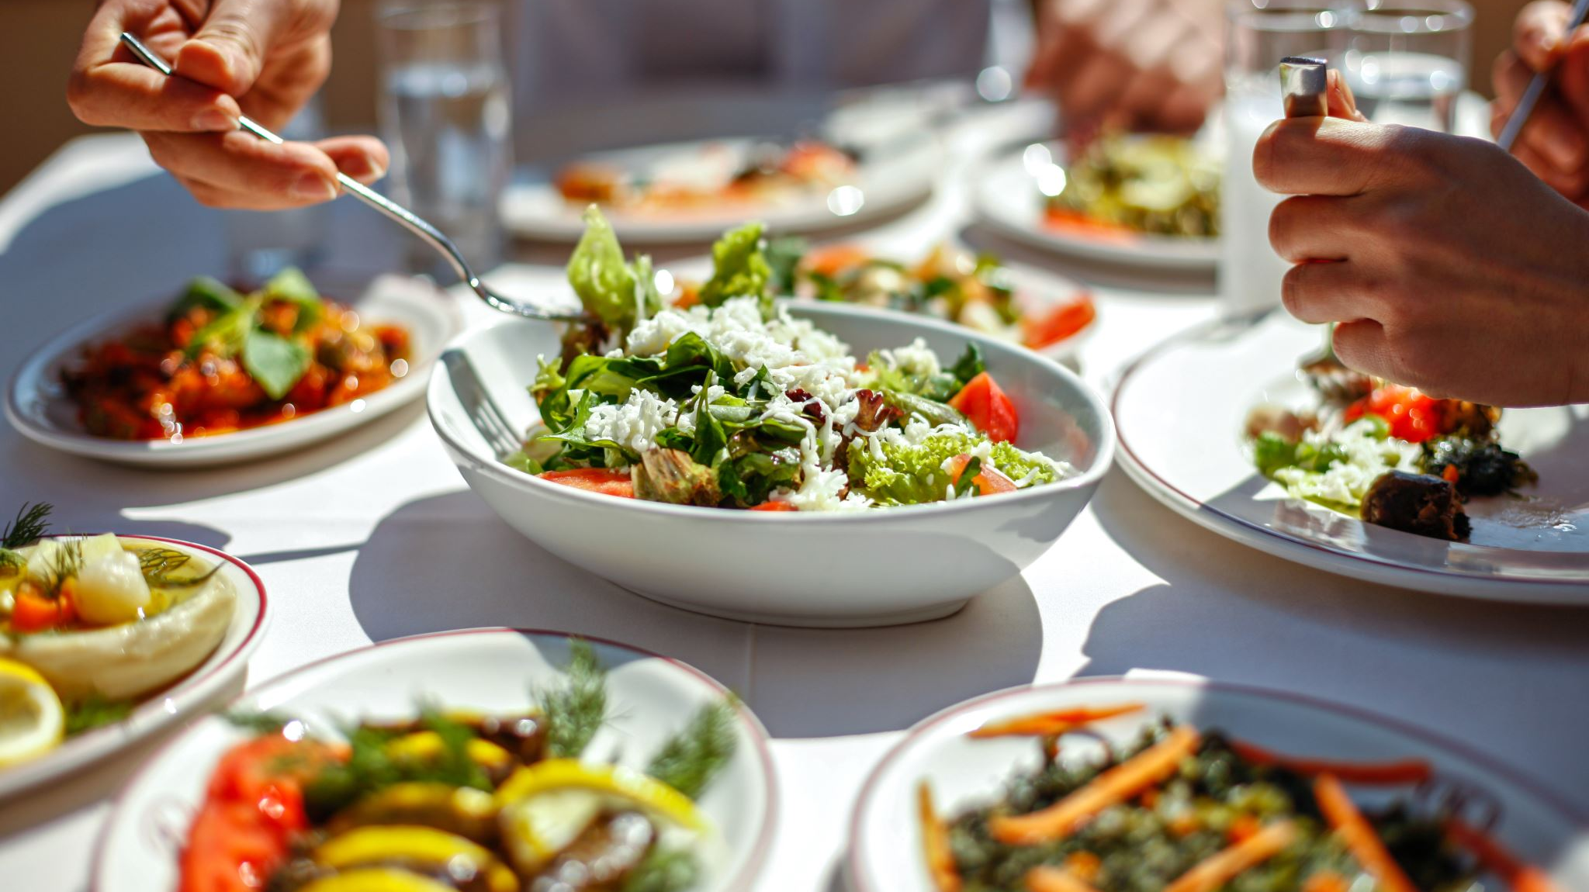
Setting your Students Up for Success: Food Pantries on College Campuses
Rachel Schichtl PHD, RD, CFCS
Assistant Professor and Didactic Program in Dietetics Director
University of Central Arkansas

Slide 2
Objectives
1. Examine current literature about food insecurity on college campuses.
2. Explore the effects of food insecurity on college campuses.
3. Discuss practical ways to set up a food pantry on college (or high school) campuses.
4. Explore other ways to support your students

Slide 3
Food Insecurity on College Campuses
Food insecurity (FI) is defined by the United States Department of Agriculture (USDA) as having limited or uncertain access to an adequate and safe food supply that promotes active and healthy lifestyles for all members of the household.
FI is highest in Oregon with 59% (Patton-Lopez, Lopez-Cevallas, Cancel-Tirado &Vasquez, 2014)
Hawaii at 45% (Chaparro, Zaghloul, Holck & Dobbs, 2009)
39% at a New York City University (Freudenberg, Manzo, Jones, Kwan, Tsui & Gagnon, 2011).

Slide 4
Continued
Freshmen at a large southwestern university are FI at a rate of 32% (Breuning, Brennhofer, Woerden, Todd & Laska, 2016)
A university in Appalachia - food insecure at some point during their first year of college at a rate of 21.5% (McArthur, Fasczewski, Wartinger & Miller, 2018)
Community college students in California experienced FI at a rate of 21.5% as freshmen (Wood & Harris, 2018)
University of Arkansas at Fayetteville- 40% (MacDonald, 2016)

Slide 5
Effects of Food Insecurity
unhealthy eating practices (Gallegos, Ramsey & Ong, 2014)
increase in the likelihood of chronic illness ( Pan, Sherry, Njail & Blanck, 2012; Parker, Widome, Nettleton & Pereira, 2010; Seligman, Laraia & Kushel, 2010)
issues with mental illness and stress (Martin, Maddocks, Chen, Gilman & Colman, 2016)
self-reported poorer health (Hughes, Serebryanikova, Donaldson & Leveritt, 2011)
higher rates of substance abuse (Lin et al., 2014)
fatigue (Munro, Quayle, Simpson & Barnsley, 2013)
and depression (Bruening et al., 2016)

Slide 6
Effects continued
There is evidence to support a relationship between FI and GPA, with students that have greater FI have the lowest GPA range (Maroto, Snelling & Linck, 2014) in community college settings.
FI in K-12 populations is detrimental to success and thus could translate to the same effect in college-aged students and their academic success (Cole & Barber, 2003; Hinton et al., 2010; Jyoti, Frongillo, & Jones, 2005).

Slide 7
Space
Where are you going to put your food pantry?

Slide 8
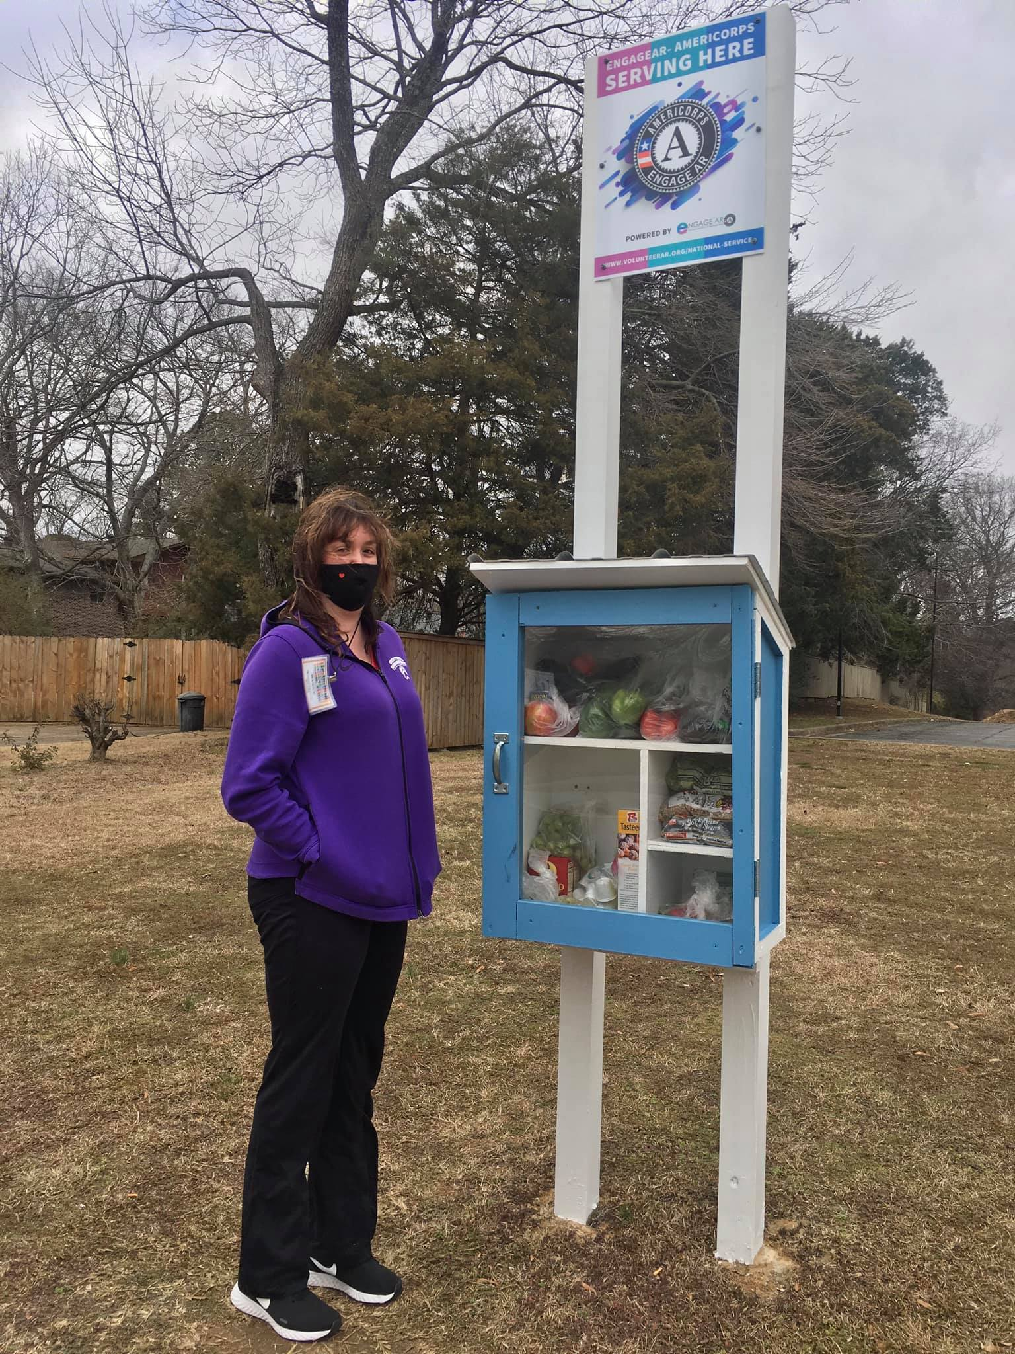
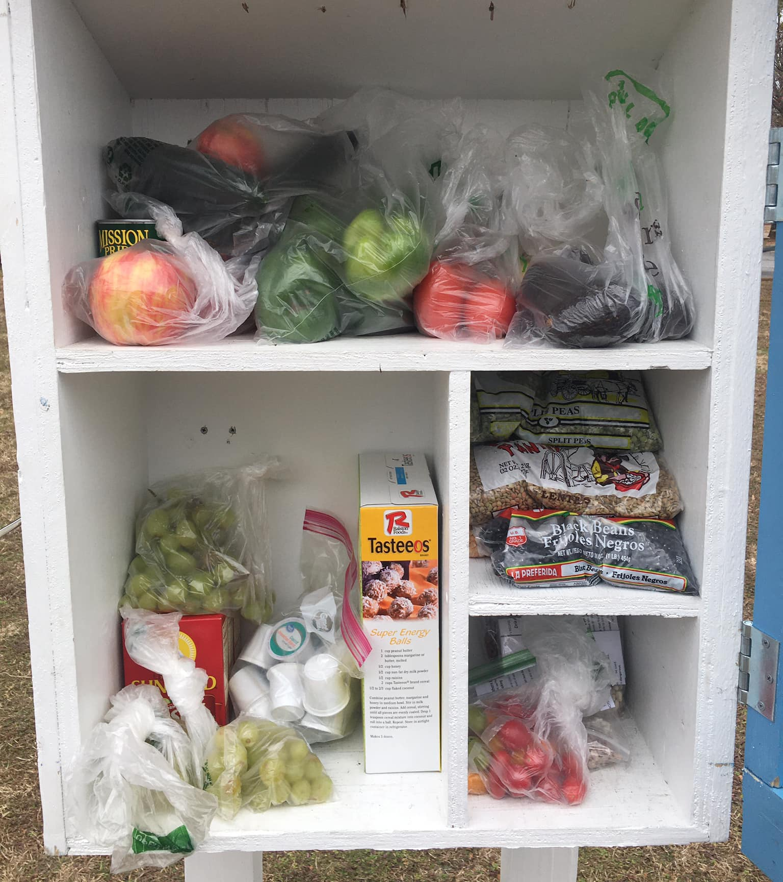
Faulkner Country Free Pantry

Slide 9
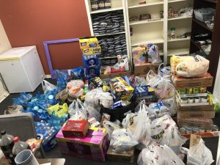
Options for Food Pantries

Slide 10
Certain Free Little Pantry (Conway High School)

Slide 11
What are some great food items to donate?
Canned fruits
Canned vegetables
Rice
Pasta
Pasta sauce
Canned soup
Oatmeal packets
Peanut butter
Jelly
Instant mashed potatoes

Slide 12
Recipients
Have a representative on Move In Day/Welcome Week
Have a statement in your syllabus with days and times
Advertise EVERYWHERE
Social Media
Offer tours as part of classes
Have a representative from SNAP come to sign up participants

Slide 13
Items besides food
Spices
Feminine Products (Student Government Association provides this)
Diapers/wipes (Non-Traditional Student Support now offers this)
Toiletries such as toothpaste, deodorant and shampoo
School supplies (binder recycling)

Slide 14
WOW Closet (World of Work)
Career Services hosts clothing/donation drives
Mock Interviews
Resume critique
LinkedIn Services
Professional Headshots

Slide 15
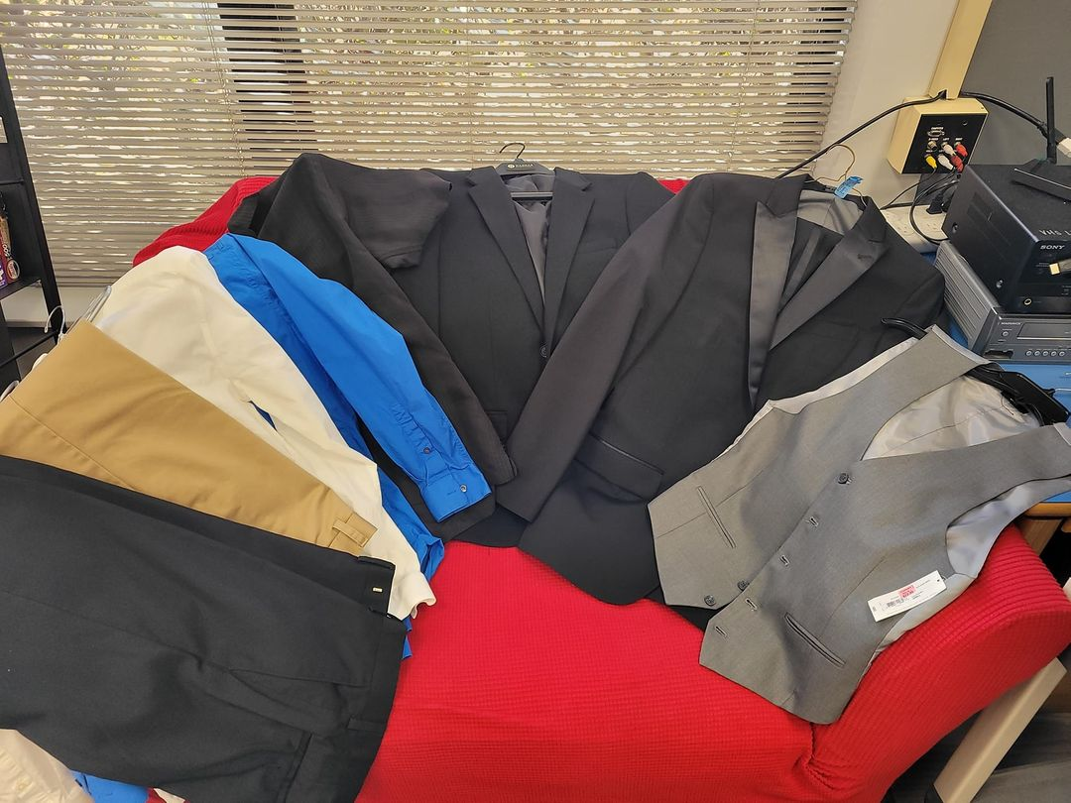
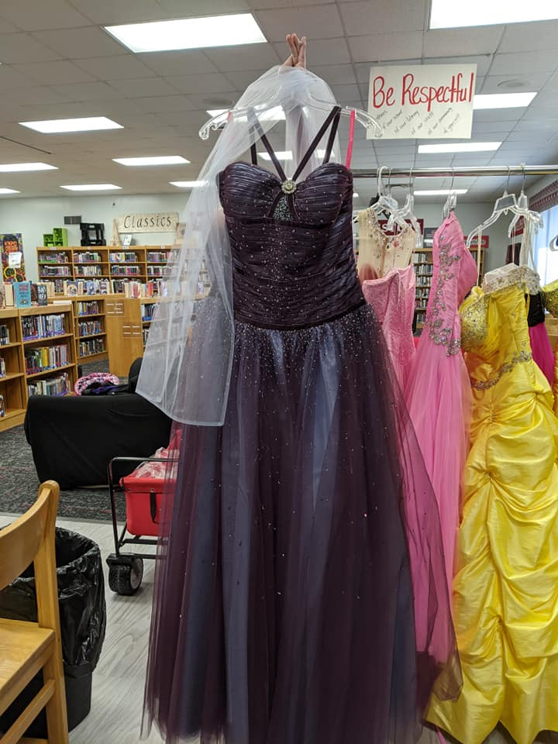
Check Out Closet
Local High School
Free to “check out”
Dressed over 65 students for Homecoming in October

Slide 16
Questions?
Contact Information:
Rachel Schichtl rschichtl@uca.edu
LinkedIn Rachel Schichtl

