Slide 1
Preparing for weather emergencies in Barbados
AUDREY A. JONES-DRAYTON, CPHE, IPHE
CARIBBEAN ASSOCIATION OF HOME ECONOMISTS INC.
March 19, 2022

Slide 2
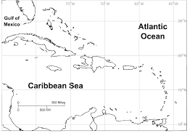

Slide 3
THE REPUBLIC OF BARBADOS
THE BROKEN TRIDENT

Slide 4
COAT OF ARMS

Slide 5
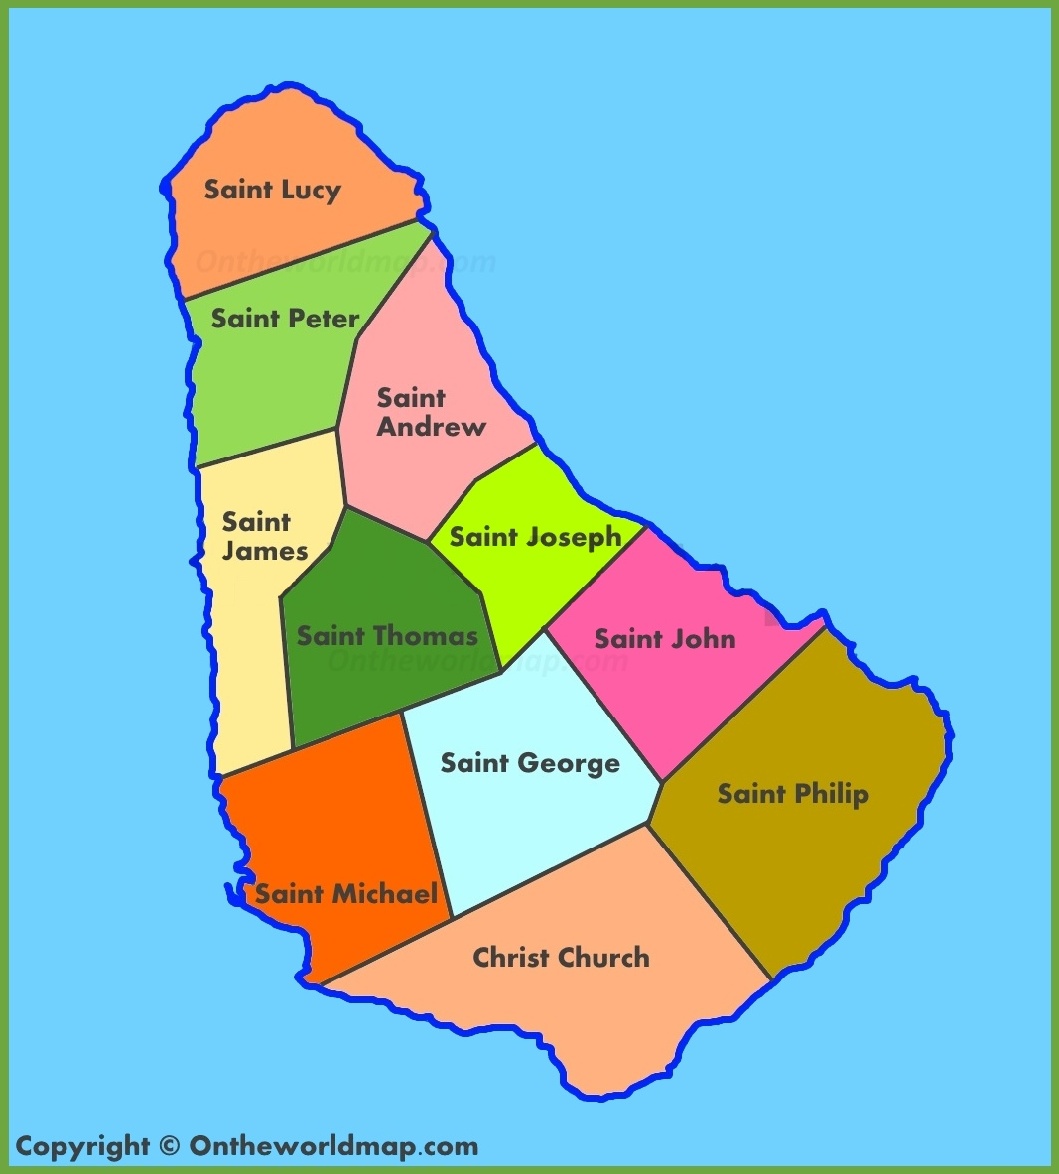
MAP OF BARBADOS
11 Parishes
166 sq. miles
21 miles X 14 miles
Population: 289,096

Slide 6
Weather defined…
The atmosphere in a location at any given time, place as affected or induced by heat, dryness, sunshine, wind, rain, pressure, moisture, etc.
Notes:
Simply put weather refers to as the state of the atmosphere in a location at a given place or time as regards to heat, dryness, sunshine, wind, rain, pressure, moisture etc. While one immediately thinks about storms and hurricane in the Caribbean we forced to consider emergencies. What comes to mind is the recent eruption

Slide 7
Weather Emergencies
Storms
Hurricanes
Volcanos
Floods
Earthquakes
Landslides
Mudslides
Tsunamis
Tornados
Drought/Wild fires

Slide 8
Old Mariners Rhyme
Is this still applicable?

Slide 10
Hurricanes to remember …
Janet
September 22, 1955
Cat 5 174 mph
38 dead

Slide 12
Signs
in the sky
Red sky at night
sailor’s delight
Red sky in the morning,
sailor’s warning (foul weather)
Matthew 16:2-3

Slide 13
Remembering Hurricane Janet 1955
No radios
No Television in most homes
Not many telephones
Bells and town criers
Horns from sugar factories
Conch shells
Word of mouth

Slide 14
Remembering Hurricane Janet 1955
Poor housing stock
Manual tools
Storm Carpenters
20,000 homeless

Slide 15
Remembering Hurricane Janet 1955
Stronger houses damaged

Slide 16
Hurricanes to remember …
Now..
Elsa
July 2021
Cat 1 85 - 100 mph

Slide 20
Emergency Management
The agency responsible for sensitizing and sanctioning preparedness in the Caribbean is the Caribbean Disaster Emergency Agency (CDEMA). https://cdema.org/ This organization is charged with overseeing, implementing and monitoring all activities within this region. All organizations and institutions, schools included, are subject to its policies.
Each state (country) has its own arm of emergency management. In Barbados it is the Department of Emergency Management (DEM) https://www.dem.gov.bb/
Local
- Community
- Regional

Slide 21
Public Service Announcements
1. The Barbados Meteorological Office notifies the public by Public Service announcements and hurricane Tracking
2. The Barbados Government Information Service
Radio
Television
Social Media
Memoranda for Central Government
- Educational Institutions
- Government and Non Governmental offices
- Transportation
- Essential officers all leave suspended.
- Closures and curfews until all clear.
Official communication channels
Armchair weathermen

Slide 22
Shoppers on red alert
Typical Bajan preparation
for weather emergencies
Don’t do this!!

Slide 23
Family Emergency Management
Do you have a family plan?
Families should:
- Familiarize family members with the plan.
Know the evacuation plan
Designate responsibility
- Collect emergency supplies: Food, water, medication, light, charging pack
- Pack evacuation bags (go-kits)
- Secure important documents in plastic/ waterproof
- Personal needs items: Masks, Toiletries,
disinfectant, sanitizer, clothes,
sanitary supplies, medications, inhalers etc.
- Make provision for pets
- Build a community support network: elderly, disabled
- Use Regional Building Code
Hurricanes/Storms
Floods
Tsunamis
Earthquakes
Volcanos

Slide 24
Emergency Management in Schools
School websites
Integrated into the curriculum
Health and Safety
Visiting speakers
Museum visits
Simulations
Tsunamis
Earthquakes
Books and story Telling
Simulations
First Aid
Roles and responsibilities.

Slide 25
Country on alert
Shopping Frenzy
Securing Boats
Boarding up of buildings

Slide 27
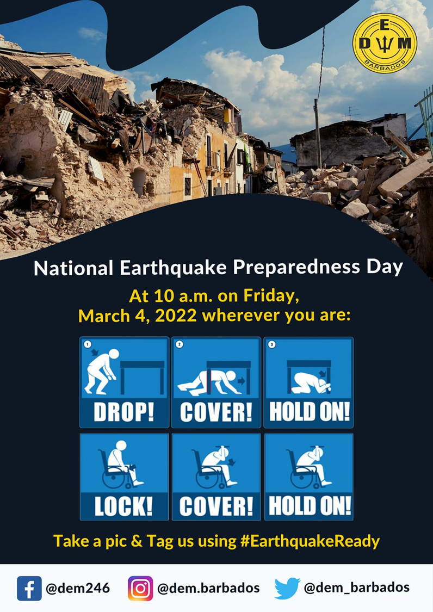

Slide 28
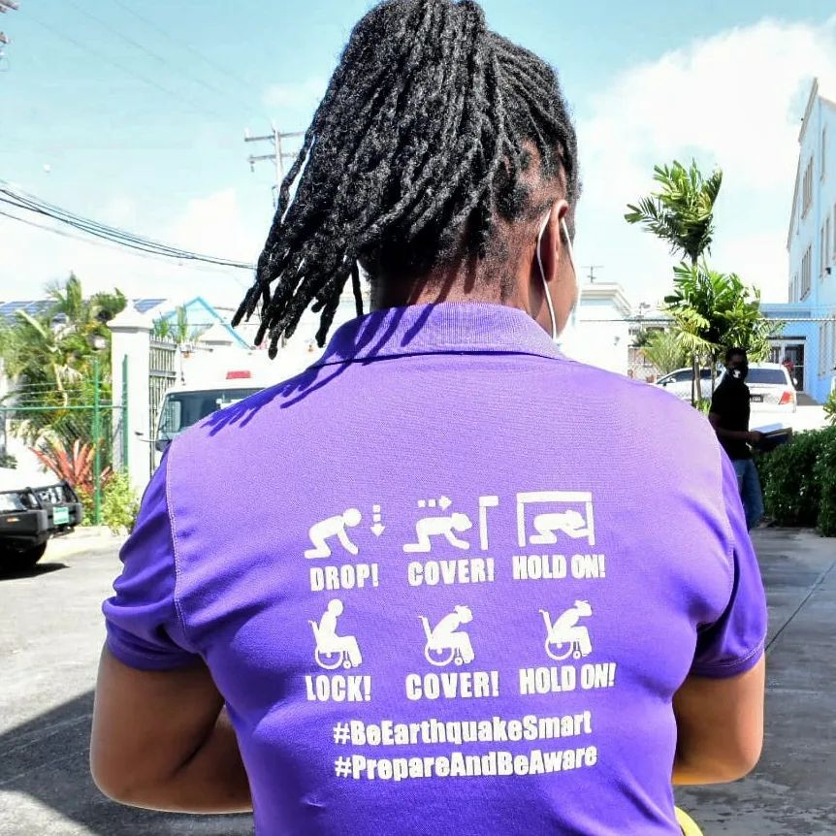

Slide 30
Prepare and be ready
Are you ready?

Slide 31
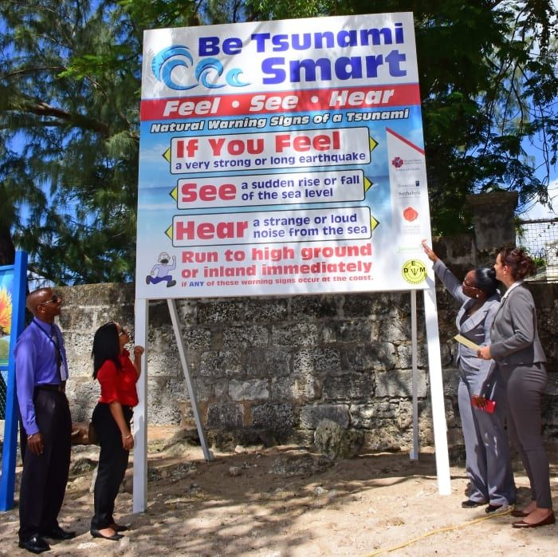

Slide 32
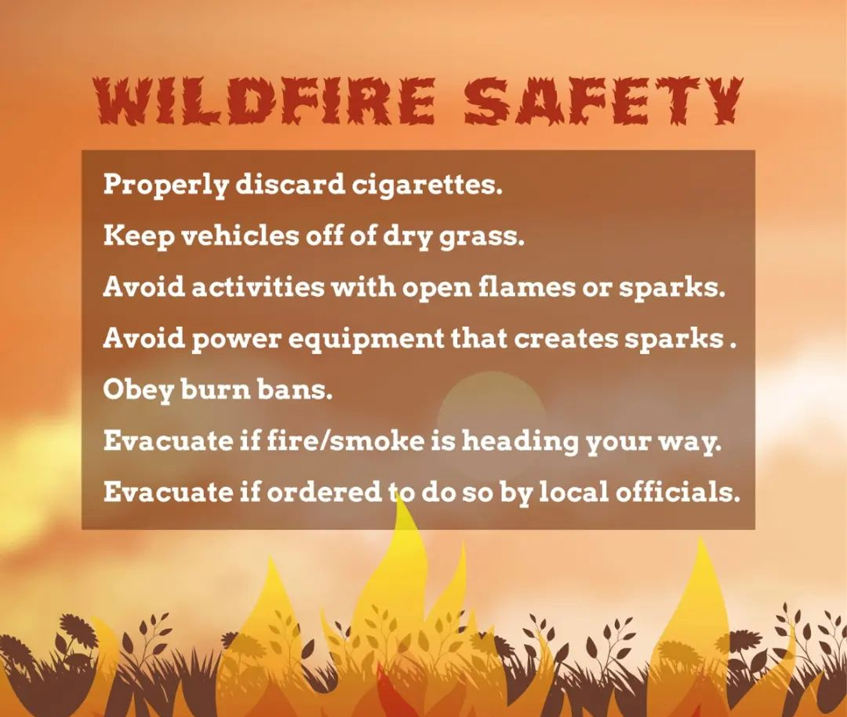

Slide 33
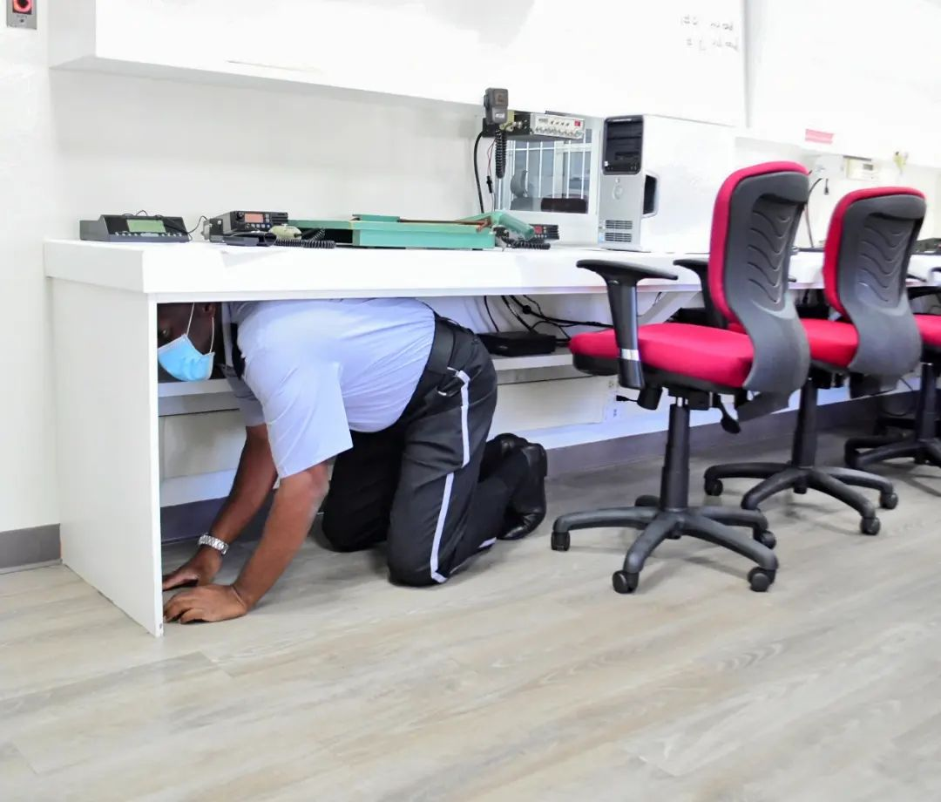
Simulation at the office. Duck ! Cover ! Hold!

Slide 34
Simulation Exercise

